Slide 1
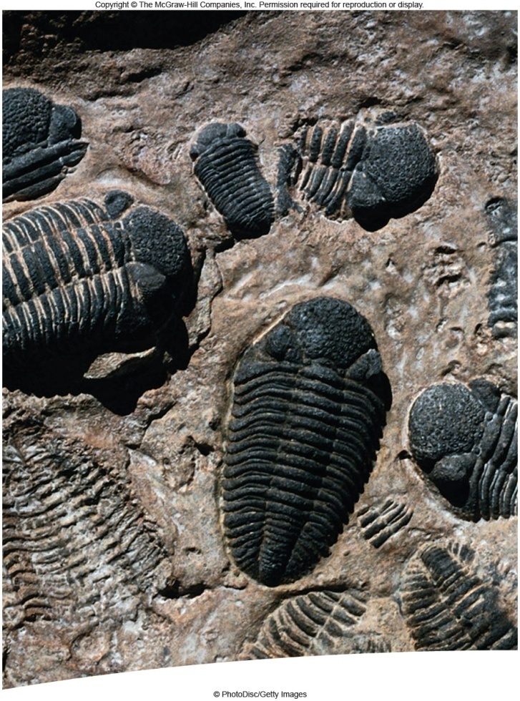
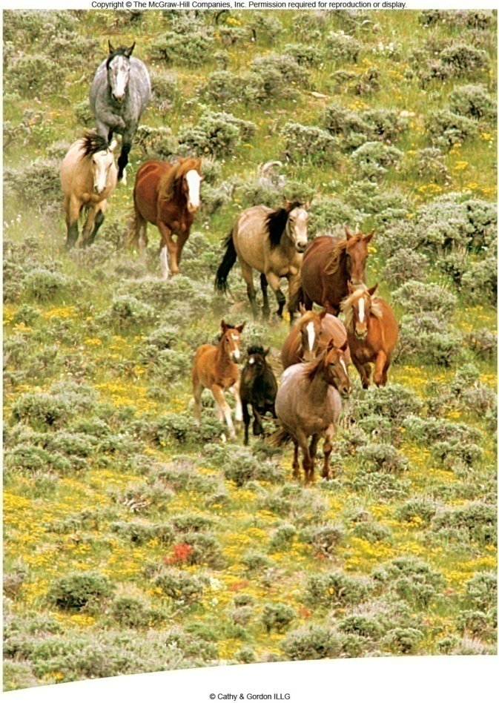
Evolution
Ch 22 and 23

Slide 2
Evolution: The process by which organism change over time. Based on science, not opinion.

Slide 3
Darwin: Evolution is descent with modification
Evolution: changes through time
  Species accumulate difference
  Descendants differ from their ancestors
  New species arise from existing ones

Slide 4
Ideas that helped Shape Darwin
Aristotle: 300 BC He viewed species as fixed or unchanging.
Organisms could be classified on a scale increasing in complexity.
Carolus Linnaeus: Made the classification system still used today.

Slide 5
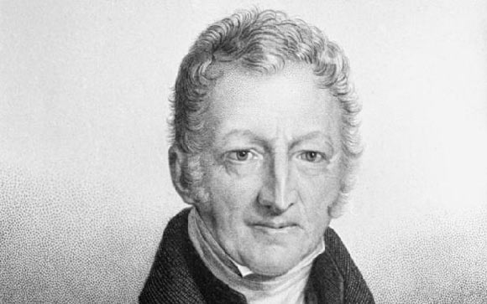
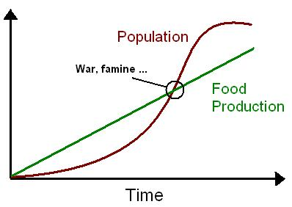
Ideas that helped Shape Darwin
Malthusian Doctrine: 1798 (Thomas Malthus) Economist: He observed that the human birth rate was higher than the death rate. If it continued, humans would run out of room and food. (Malthusian Doctrine referred to during famine, war and mass disease)
Competition for resources will cause variations.

Slide 6
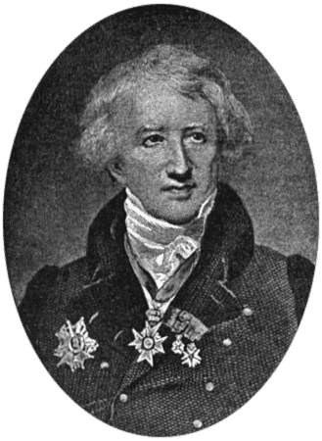
George Cuvier: Paleontologist 1760’s 1830’s.
The older the stratum of Rock the more dissimilar the fossils are from current life forms.
Also noticed that some species disappeared and new species appear. Extinction. Not a believer in Evolution.

Slide 7
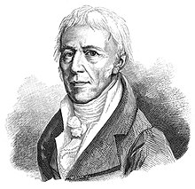
Early Ideas of Evolution
Jean-Baptiste de Lamark: 1744-1829
Lamarck’s theory: Before Darwin. first to realize living organisms change over time. (Published 1809)
By selective use or disuse of organs and that organisms acquired or inherited characteristics which were passed on to their offspring.
He also thought that evolution occurred because organisms had a inate drive to become more complexed.
He did recognize global evolution.

Slide 8
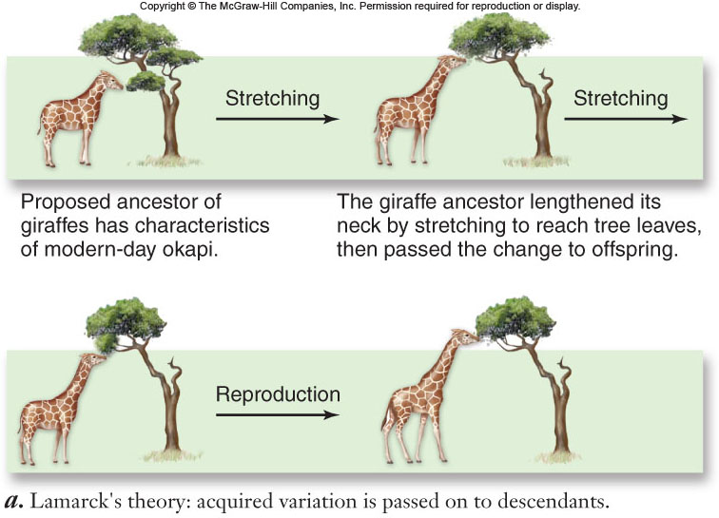
Lamarck’s theory of how giraffes’ long necks evolved

Slide 9
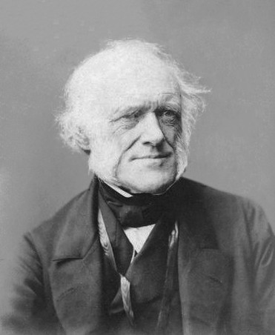
Ideas that helped Shape Darwin
Charles Lyell’s Book: Principle of Geology 1820’s
That proposed the Earth was Millions of Years Old not a few thousand.
Deep Time
When he found ocean floor fossils he referred back to this book. Influenced by James Hutton (Father of Modern Geology) they proposed that the same geologic principles that occur today must have occurred in the past. Law of Uniformitarianism.

Slide 10
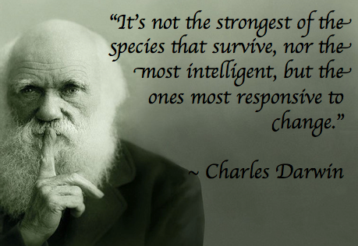

Slide 11
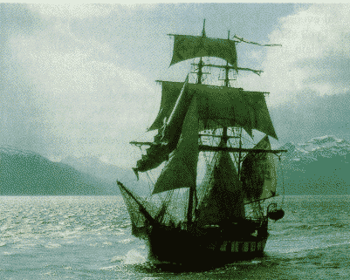
Charles Darwin:
Charles Darwin: (1809 - 1882) HMS Beagle. Traveled around the world to
collect specimens at the age of 23 in 1831.
Galapagos Islands: (Finches and Tortoises)
Wrote: “The Origin of Species by Means of Natural Selection”.
Degree in Theology from Cambridge University

Slide 12
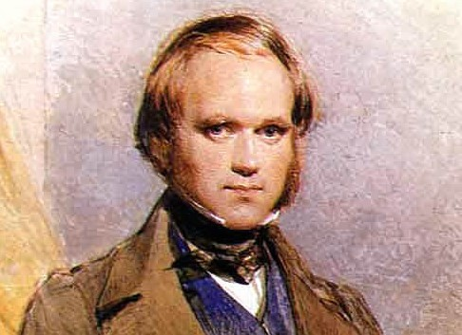
Darwin's Travel
Read and used Lyles Book;
Experienced Geologic Change due to an Earthquake. He noticed the uplifting of rocks.
Found Fossils of ocean critters in the Andes. He inferred that the rocks were uplifted.
Galapagos Island unusual organisms. They resembled organisms from the mainland of South America.

Slide 13
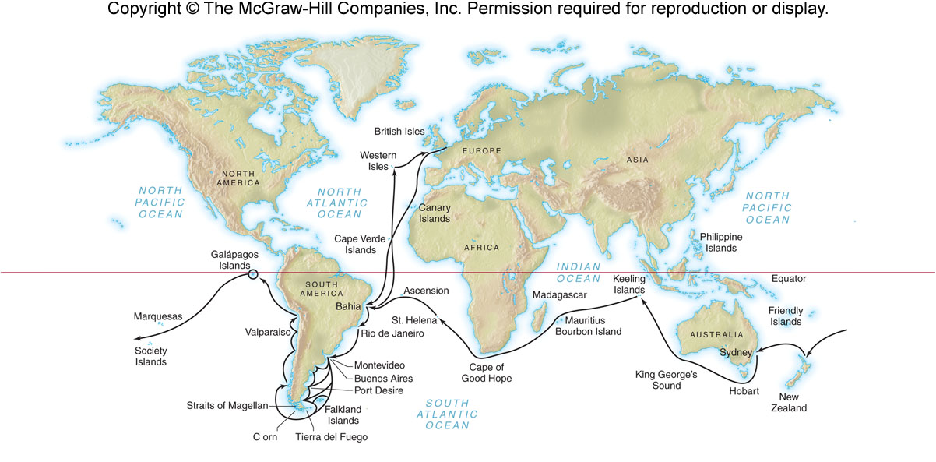
Voyage of the Beagle

Slide 14
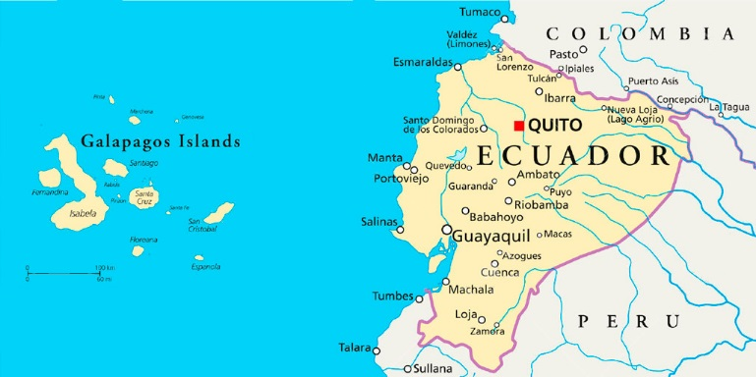
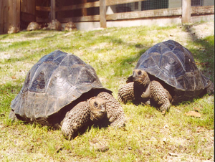
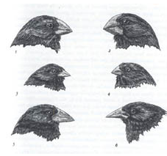
Galapagos Islands
small group of volcanic islands
no land mammals or amphibians
Back in England he looked at his findings
  Tortoises and Finches

Slide 15
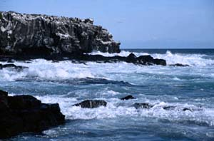
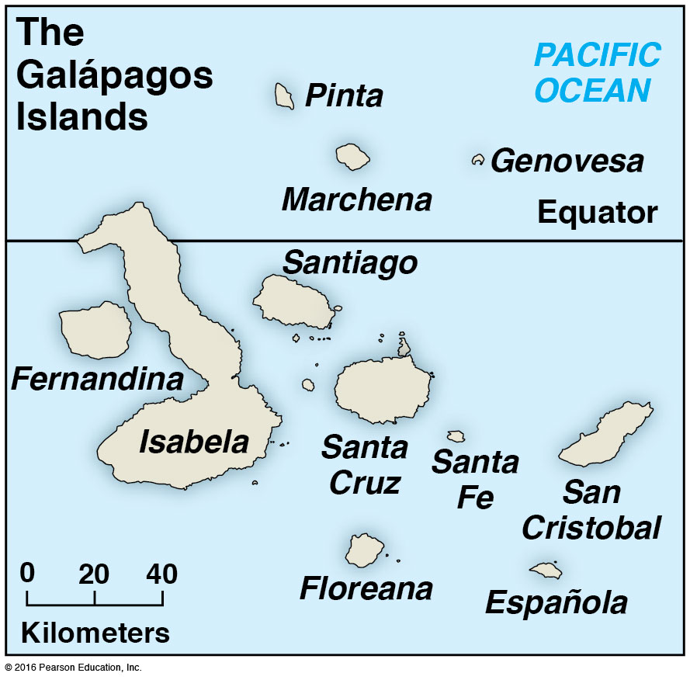
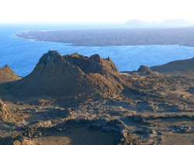
Galapagos Islands

Slide 16
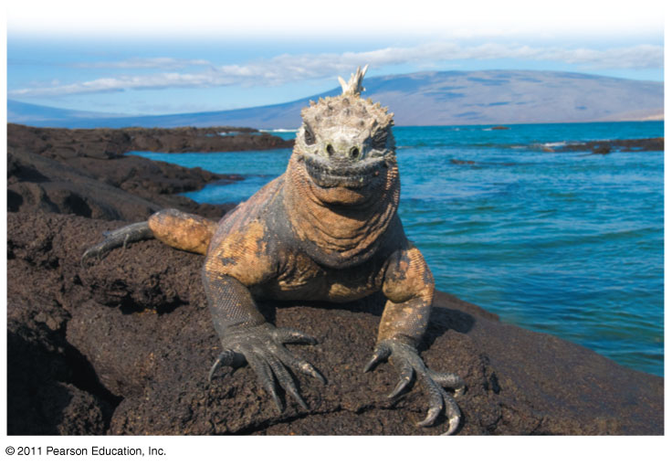
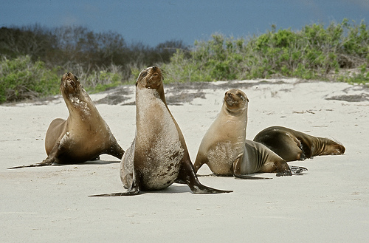
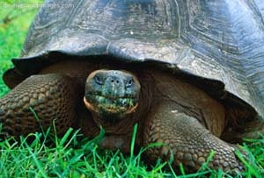
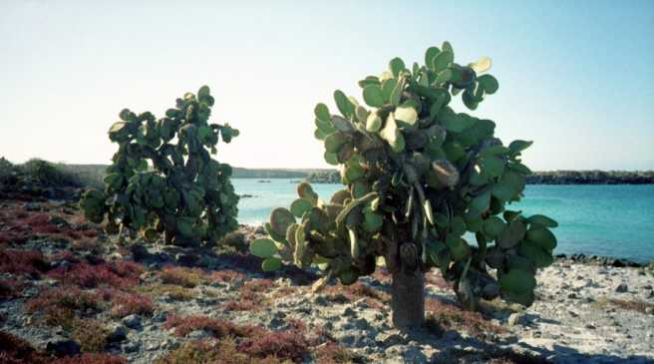
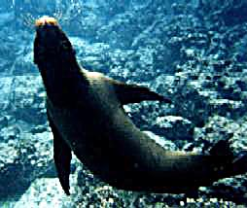

Slide 17
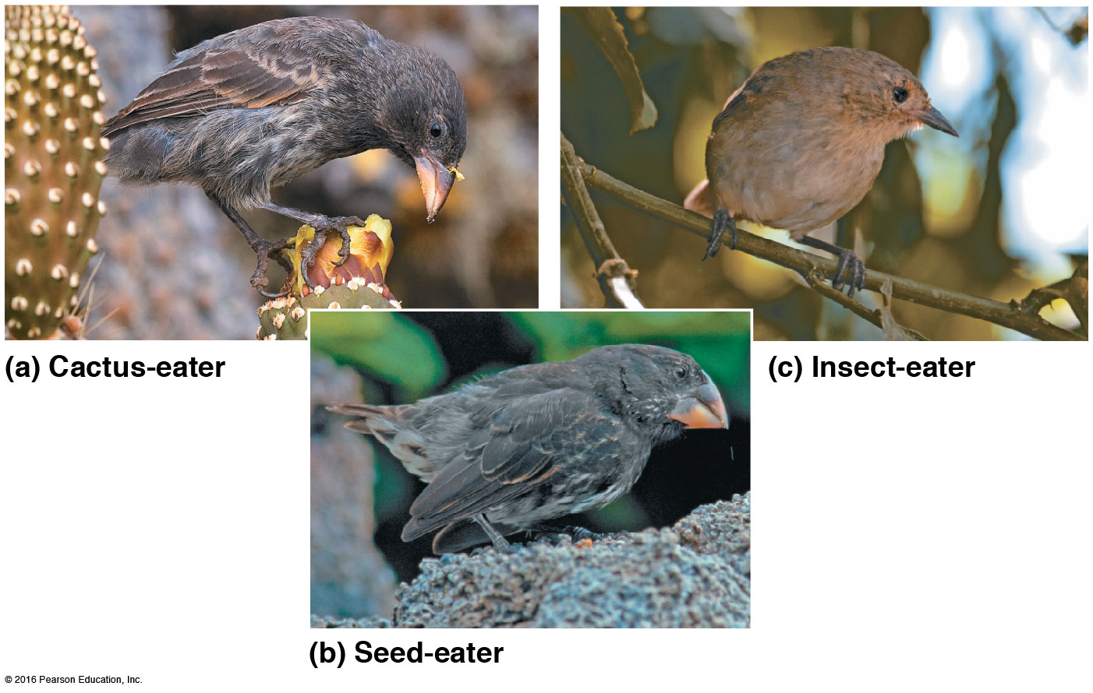
Darwin’s Finch Collection
The birds were all about the same size, but the shape and size of the beaks of each species were different.

Slide 18
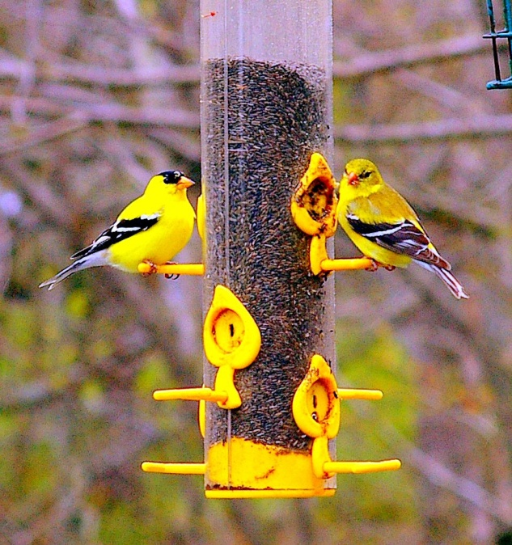
Finches
  All had differentiated into 14 species
    different beaks specialized for a particular food source
Conclusion
  ancestral group of finches colonized islands
  Absence of competitors allowed finches to gradually become specialized

Slide 19
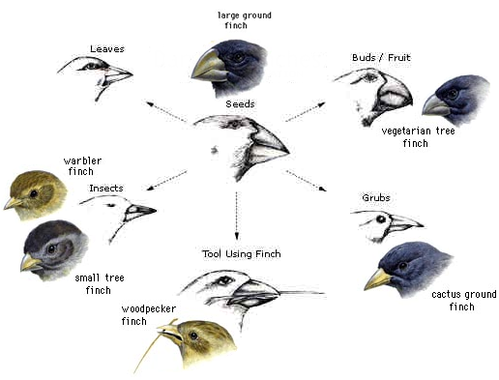

Slide 20
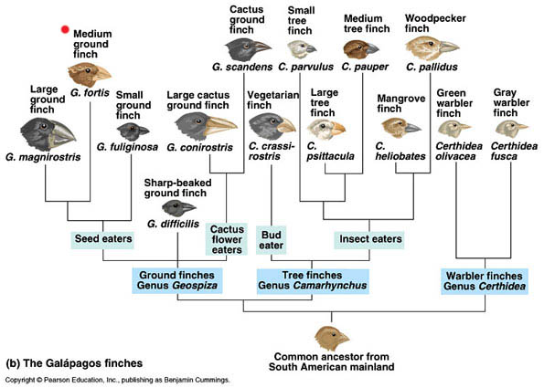

Slide 21
Darwin’s Focus on Adaptation
Adaptation: Having a mutation which enables an organism to survive and
reproduce better. (without adaptation, species would become extinct)
(Remember, over 99% of all species on earth have already become extinct)

Slide 22
Natural Selection
Adaptation: Species pass on inherited traits that increase their ability to survive in specific environment
  Eg. Desert fox - large ears, arctic fox - small ears
  He had internal Conflicts with his new ideas.

Slide 23
Natural selection
3 conditions for natural selection to occur
  Variation must exist among individuals in a population
  Variation among individuals must result in differences in the number of offspring surviving
  Variation must be genetically inherited

Slide 24
1. Variation within a population
2. Variations are passed on
3. More offspring are produced than can survive
4. Organisms that survive have favorable variations (adaptations)
Fitness – genetic contribution to next generation
Environment “selects” traits
  Favorable traits depend on demands of env’t
Reproduce more
Greater fitness
Better adapted

Slide 25
Published 30 years after the voyage.
It explained that evolution is a long slow process.
All organisms have a common ancestor (Common descent) and are descendents from other species.
He knew this would cause people to have problems. His own wife was against it.
He kept collecting more evidence.

Slide 26
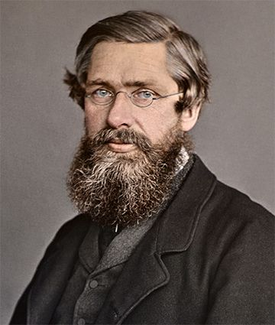
Mid 1850’s he let a few people see a manuscript.
Lyell was not convinced yet of evolution urged him to publish before another came to the same conclusion.
Alfred Russel Wallace, 1858 working in Malaysia did and asked Darwin to read his findings. They were identical! Darwin soon published his findings.

Slide 27
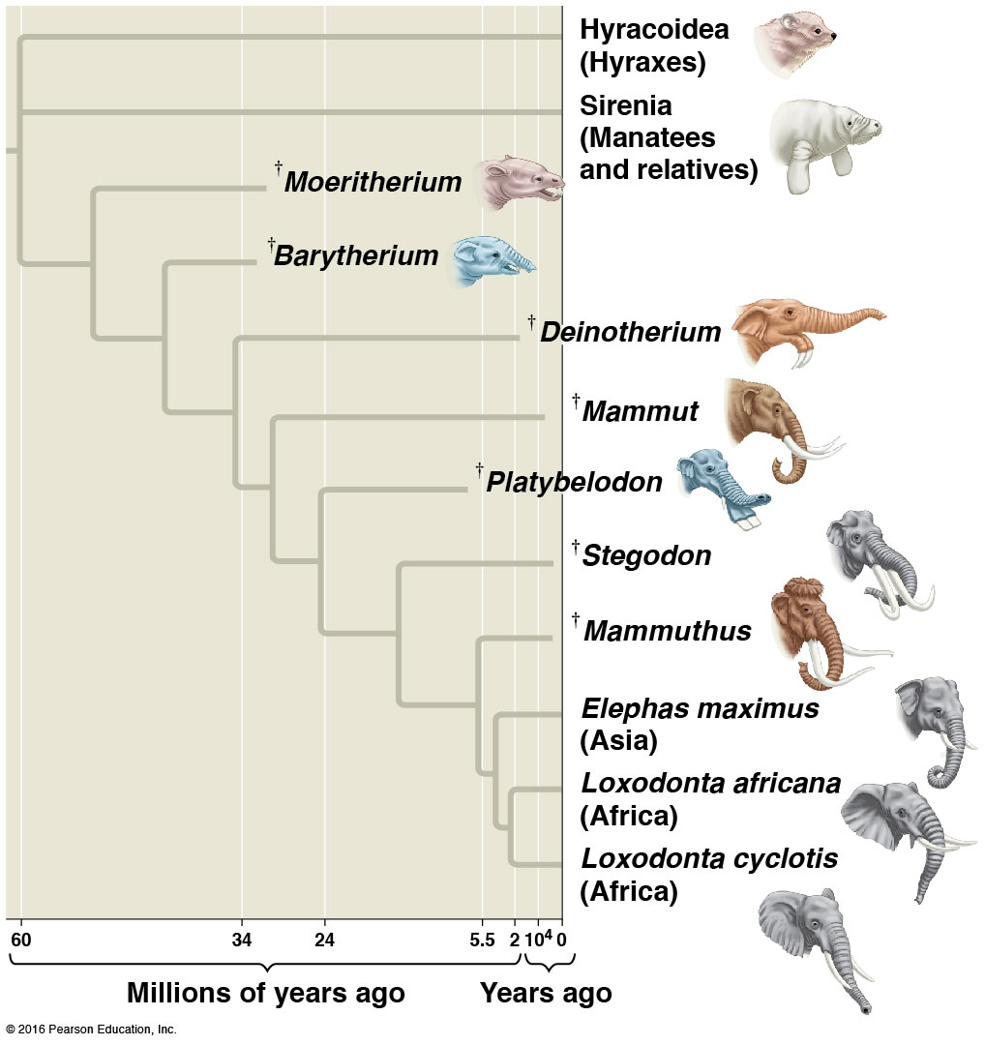
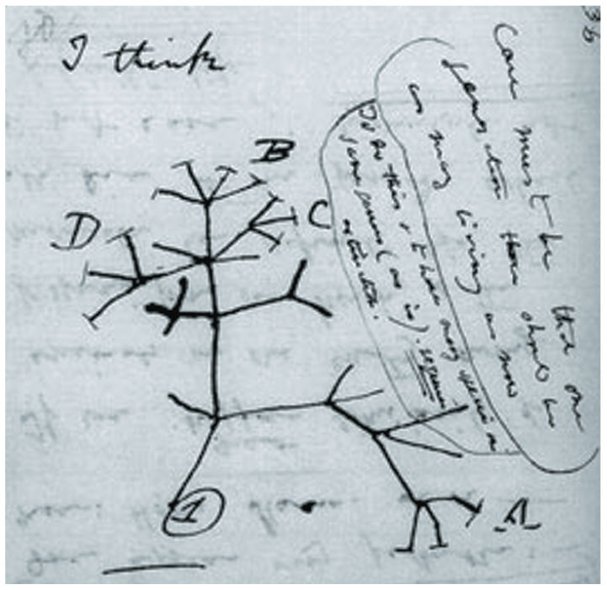
Descent With Modification
Organisms descended from an ancestor that lived in the remote past
“I think ...
A scetch by Darwin

Slide 28
Artificial Selection: People select the desired traits in the parents so the offspring
will possess those desired traits. (ex. farmers = corn, or cows etc) ( dog breeder
= good hunting dog, friendly, guard dog etc. )

Slide 29
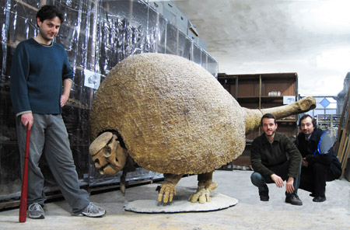
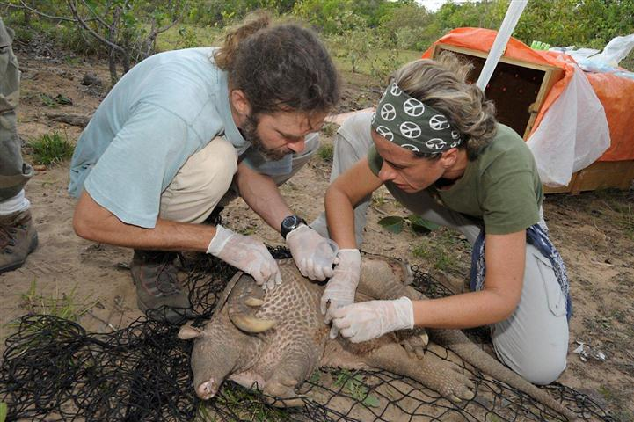
Evidence For Evolution
He also saw that certain places contained a certain species that changed as we looked thought the fossil record.

Slide 30
Fossils Evidence
Fossil Records: Preserved remains of and traces of old organisms found in Sedimentary rocks.
* Strata new layers of rock cover older layers.
* Imprints.
* molds
Used for Relative Dating
Darwin found Fossils of ocean critters in the Andes. Using Ideas of Lyell and Hutton as well as Volcanism he concluded the Earth was much older.

Slide 31
Absolute Dating:
Radiometric Dating: (ex. Carbon 14 and Potassium 40)
Geologist. People who study rocks and land forms. (Pangea, Continental Drift,
Mid-Atlantic Ridge).

Slide 32
Mass Extictions
Five separate Mass Extinctions
(time line of the earth) Eras and periods.
Precambrian Time: 90 % of Earths history. Few fossils. First organisms at 3.3 BYA
Archea Bacteria/Cyanobacteria
2.2BYA first pollution crisis. Free Oxygen. O₂ increased from 1% to 15% of the Atmosphere. This was toxic to most Bacteria. Some that survived used O₂ to produce energy. Respiration!!

Slide 33
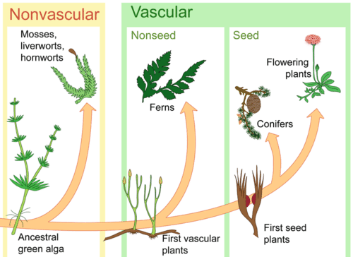
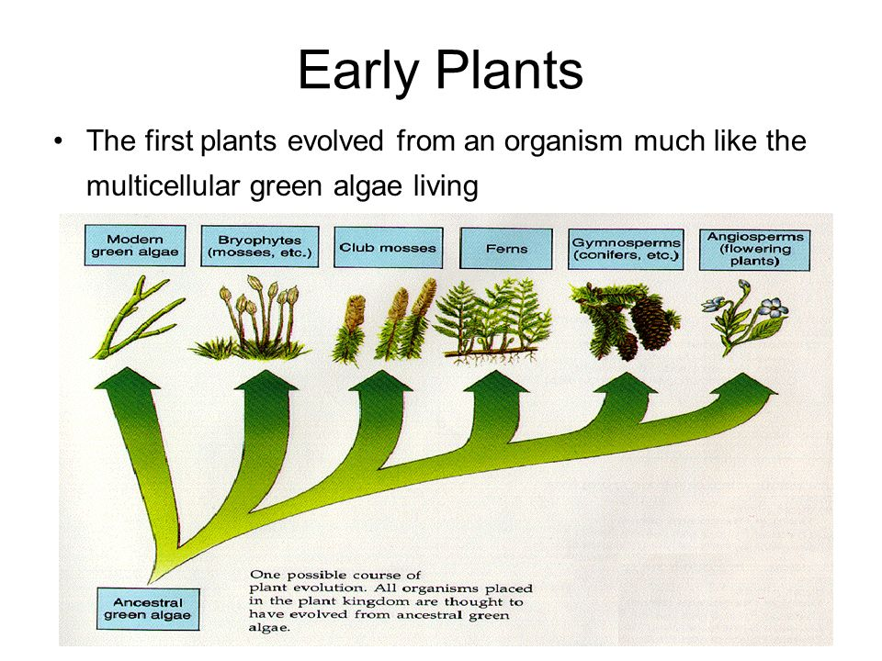
First plants
Evolved somewhere about 3million years ago from photosynthetic prokaryotes such as Cyanobacteria,

Slide 34
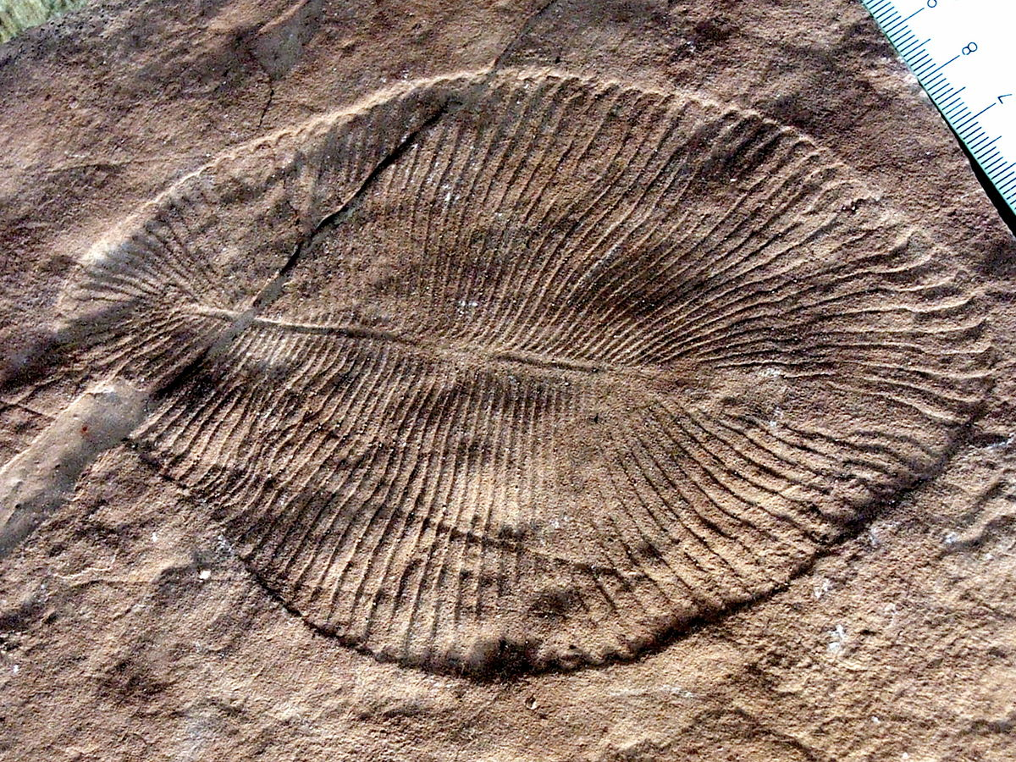
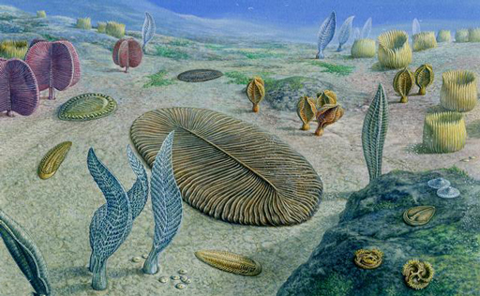
First Animals
600 Million Years ago
Ediacaran Animals

Slide 35
Paleozoic Era: (544 - 245 millions years ago)
Ordovician Period: 44MYA
  3rd largest Mass Extinction
  Mostly Sea Creatures like Graptolites, Trilobites and Brachiopods. Caused by Increasing Ice lowering Sea-levels.
Silurian Period: Many Firsts. Jawless fish appear, terrestrial organisms: ancestors to spiders and Insects, Vascular plants. Fungi.

Slide 36
End of Paleozoic Era
Began about 251MYA Mass Extinction 96% of all life died off. Today all organisms are decedents of the surviving 4%.
      Effected Corals. Took 100million years to form new corals.
      Rocks from this time period show no coral reefs or coal deposits.
Ended about 220 million years ago

Slide 37
Mesozoic Era: (Age of the Reptile)
Triassic Period: 200 MYA lost 80% of species. Mass Extinction Caused by Basalt Lava flows, Asteroid impacts and Climate Change. 18million Years.
Jurassic Period:(DINOSAURS RULED)
Cretaceous period: small mammals

Slide 38
MASS EXTINCTION AT END OF MESOZOIC ERA:
K-T Extinction or Cretaceous-Tertiary Extinction
Over 50% of all life died, Including most dinosaurs.
What Caused this event??

Slide 39
Cenozoic Era: (65 mya - present) (Age of Mammals)
Tertiary Period
Quanternary Period

Slide 40
Punctuated Equilibrium
Niles Eldred and Stephen Jay Gould:
Punctuated bursts of evolution that occur in very short periods of time.
Problem
If Rapid changes occur to organisms in natural selection why so long without changes?
Both at work.

Slide 41
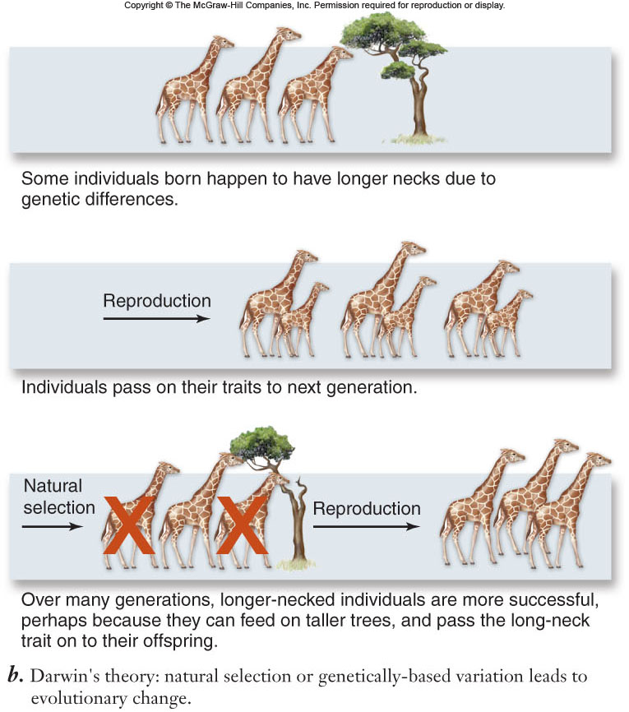
Darwin’s theory for how long necks evolved in giraffes

Slide 42
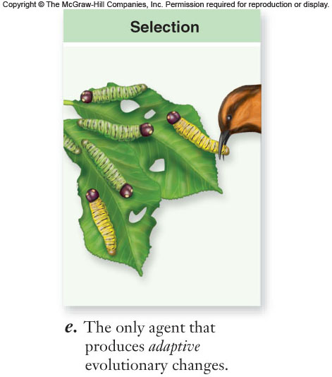
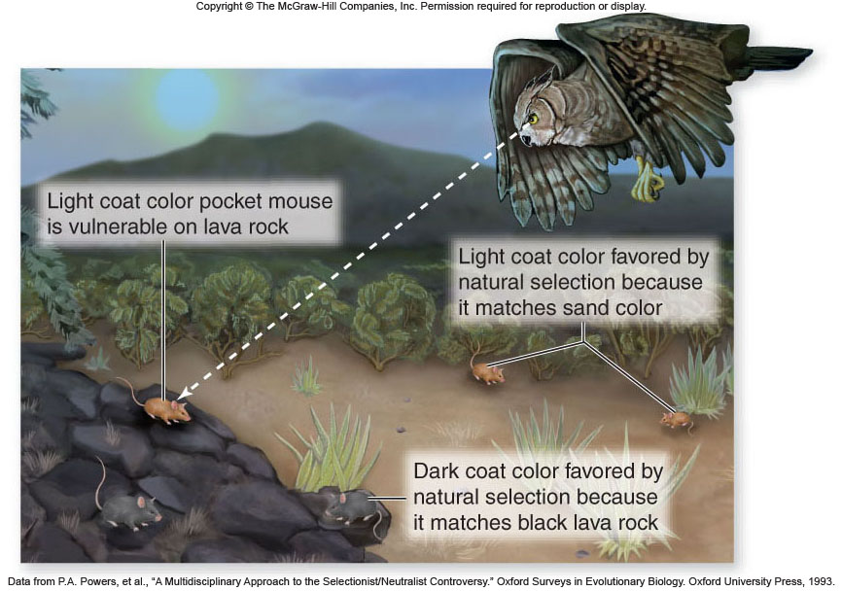

Slide 43
Evidence for Evolution:
Direct Observations
Homology
  Physical
  Biochemical
Fossil Record
Biogeography

Slide 44
Therefore, if humans can create substantial change over short time, nature can over long time.
Natural Selection | Artificial Selection
Nature decides | “Man” decides
Works on individual | Selective breeding
 | Inbreeding occurs
eg. beaks | eg. dalmations

Slide 45
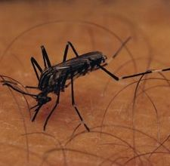
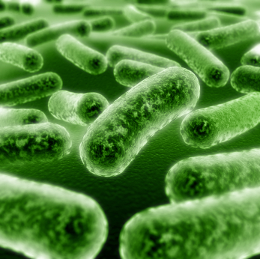
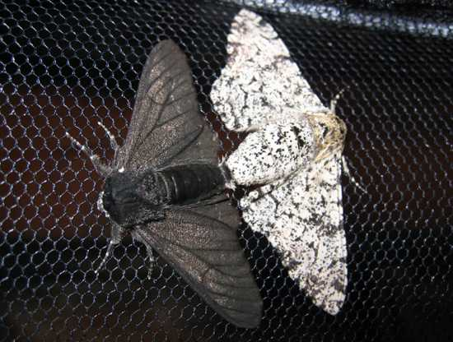
Evidence for Evolution:
1. Direct Observations
Examples:
Insect populations become resistant to pesticides (DDT)
Antibiotic-resistant bacteria (MRSA)
Peppered moth (pollution in city vs. country)

Slide 46
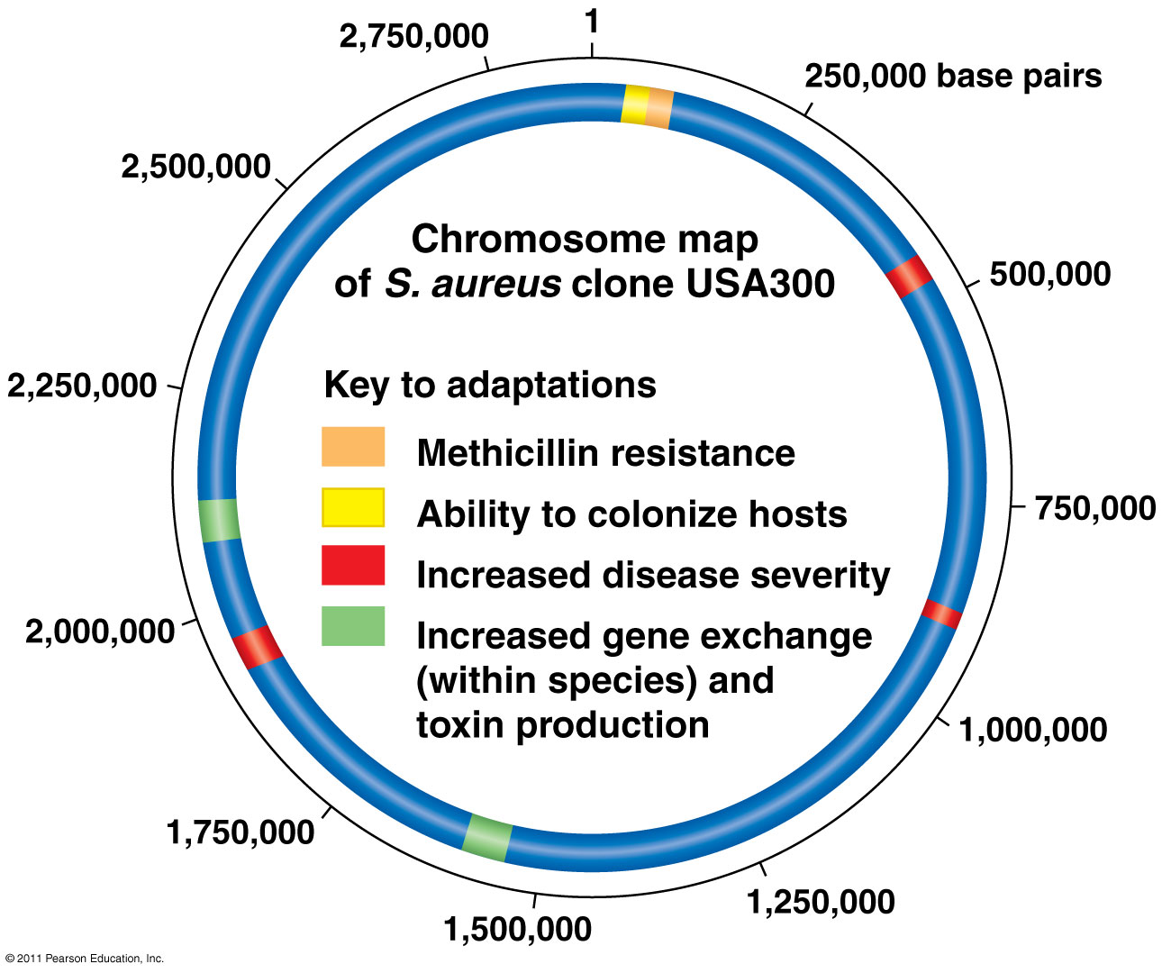
The Rise of MRSA
(methicillin-resistant Staphylococcus aureus)

Slide 47
Evidence That Suports Darwin’s Theory:
Farmers / Breeders: Farmers altered and improved their own livestock though selective breeding Techniques. (Artificial Selection)
  He noticed this with Pigeons.
Population Controls: Over time conditions prevent the endless growth o a population. (Malthus)
1. Famine 2. Disease
3. War 4. Drought
These apply to plants as well as animals.

Slide 48
Evidence for Evolution:
2. Homology
Homology: characteristics in related species can have underlying similarity even though functions may differ

Slide 49
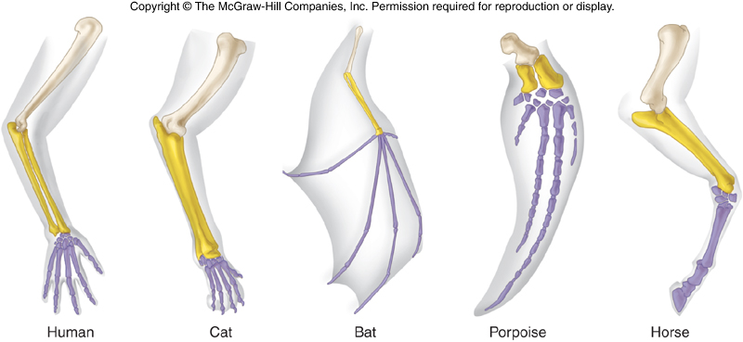
Homologous Structures

Slide 50
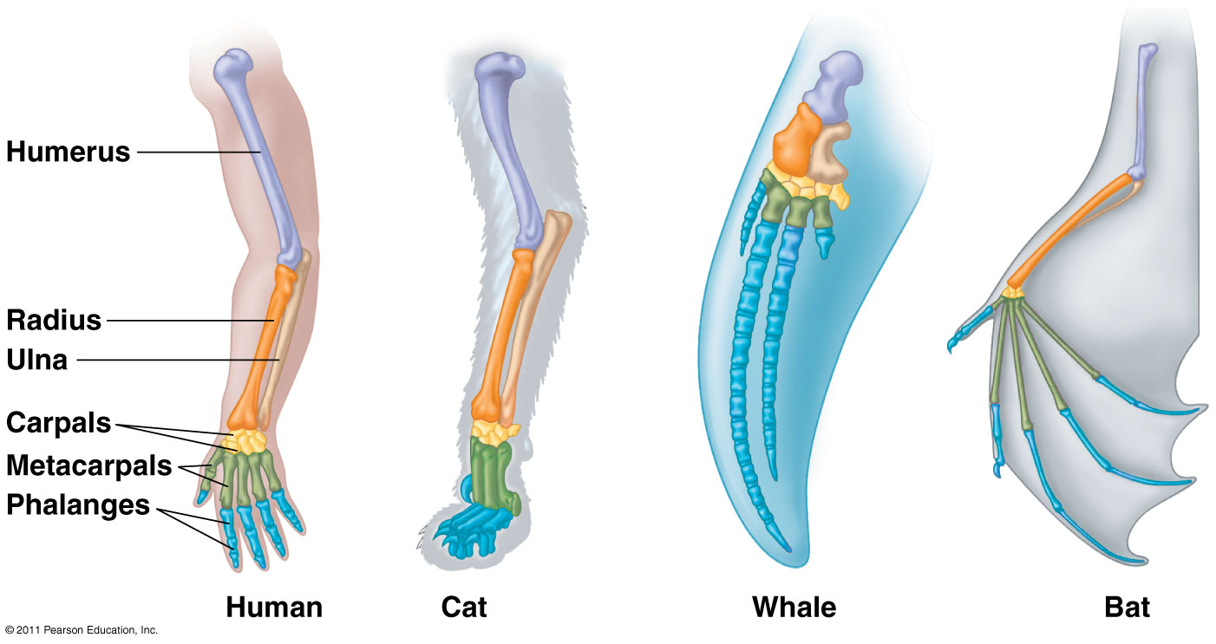
Homologous structures: similar anatomy from common ancestors (eg. forelimbs of human/cat/whale/bat)
Similar features that originated in a common ancestor
Develop from same embryonic structure
Have similar structure but different functions

Slide 51
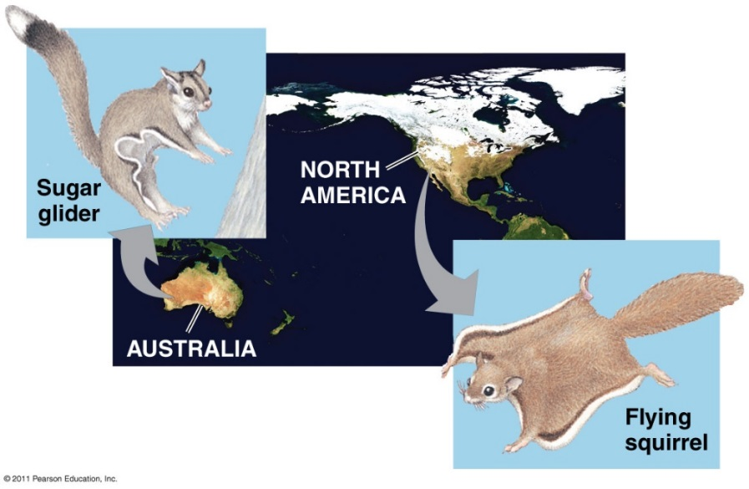
Convergent Evolution
Distantly related species can resemble one another
Similar problem, similar solutions!
Analogous structures: similar structures, function in similar environments
  Eg. Torpedo shape of shark, penguin, & dolphin

Slide 52
Convergent Evolution: Unrelated organisms evolve similar body parts which best suits
the environment. (dolphins, fish, penguins all have similar body shapes and parts.)
http://www.pbs.org/wgbh/nova/evolution/evolution-action-salamanders.html
Notes:
New tool: Embedded a web page address that helps to describe convergent evolution.

Slide 53
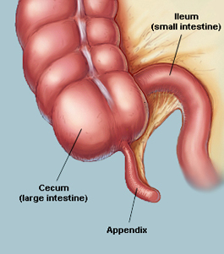
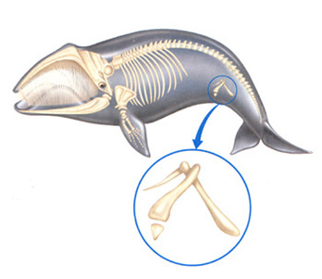
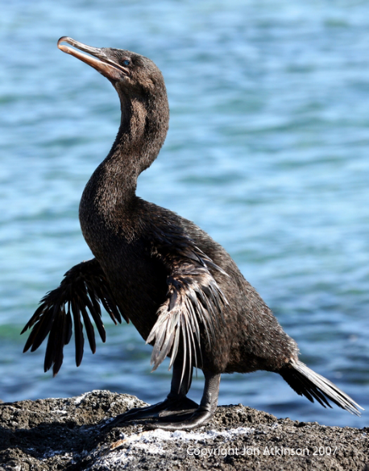
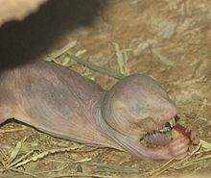
Vestigial Structures: structures w/little or no use (eg. flightless bird wings)
  Organism with vestigial feature share common ancestry with an organism that has a functional version of the same feature

Slide 54



Whale
Snake

Slide 55
Post-Darwin Evolution Evidence
Comparative anatomy
- Homologous structures have same evolutionary origin, but different structure and function.
- Analogous structures have similar structure and function, but different evolutionary origin.

Slide 56
2. Similar Body Structure:
* Homologous Structures
Bird wings, dog legs (same bones)
* Vestigial organs.
(don’t serve a function anymore. Tail bone, appendix, ear muscle, legs on snakes, etc)

Slide 57

Embryonic homologies: Similar early in development (eg. vertebrate embryos with tail & pharyngeal pouches)\
  gill slits, notochord. Etc.
  Similarity in all cells(Organelles, mitosis, meiosis, Energy use & DNA base pairs.

Slide 58

Embryonic Stages

Slide 59

Molecular homologies: similar DNA and amino acid sequences
  Compare DNA and amino acid sequences
  The more similar the proteins are in different species the more closely related the species are
Molecular clock – some genes and other regions of genomes appear to evolve at constant rates
  A lot of changes/mutations in a gene must mean the species has been around longer
  The greater the similarity, the more recently the organisms are considered to have diverged from a common ancestor
Our increased understanding of DNA and protein structures has led to the development of more accurate phylogenetic trees
https://www.youtube.com/watch?v=lIEoO5KdPvg

Slide 60

Post-Darwin Evolution Evidence
Molecular Evidence
- Our increased understanding of DNA and protein structures has led to the development of more accurate phylogenetic trees.
https://www.youtube.com/watch?v=lIEoO5KdPvg

Slide 61

Evidence for Evolution:
3. Fossil Record
Fossils = remains or traces of organisms from past
  Found in sedimentary rock
Paleontology: study of fossils
Show evolutionary changes that occur over time and origin of major new groups of organisms
Ankle bones

Slide 62


Transitional forms = fossils that contain features of several species (links to modern species)
  Derived trait – new traits not in ancestral species
  Ancestral traits – primitive features in ancestral species
Archaeoptyerx

Slide 63
Evolutionary Tree: A linear chart showing how species might be related.
http://www.bozemanscience.com/cladograms
Adaptive Radiation: One species evolved into many different species.
Coevolution: Two unrelated organism evolve together and become dependent on each
other. (ex. Certain bees and flowers
http://www.bozemanscience.com/coevolution
Notes:
New Tool: Hyperlink to the Bozeman Science web page. This will help students to learn about evolution and how species evolve.

Slide 64


Evolutionary Tree: A linear chart showing how species might be related.
http://www2.sluh.org/bioweb/bi100/focussheets/fssolfiles/fssolchordate.htm#t9r-d
http://www.bozemanscience.com/cladograms
Principle of Parsimony: The best hypothesis has the fewest assumptions.
In evolution it would have the fewest evolutionary events.
Notes:
New Tool: Hyperlink to the Bozeman Science web page. This will help students to learn about evolution and how species evolve.

Slide 65

Evolutionary Tree

Slide 66


Slide 67

Adaptive Radiation: One species evolved into many different species.

Slide 68

Adaptive Radiation

Slide 69
Evidence for Evolution:
4. Biogeography
Biogeography = geographic distribution of a species
Species in nearby geographic areas resemble each other
Continental drift and Pangaea explains similarities on different continents
Endemic species: found at a certain geographic location and nowhere else
  Eg. Marine iguanas in the Galapagos

Slide 70

Island Biogeography

Slide 71

Galapagos Tortoises

Slide 72
Biogeographic Isolation
This leads to Reproductive isolation.
**Once Reproductive isolation happens natural selection usually increases the difference between separate populations

Slide 73
Behavioral Isolation
3. Obtaining Food. The individuals that obtain food the easiest will look much healthier and therefore have a better chance of mating.
Mechanical Isolation: Shape of body or body parts.
http://www.bozemanscience.com/003-genetic-drift

Slide 74
Endosymbiosis
Endosymbiosis
-proposal that eukaryotic organelles evolved through a symbiotic relationship
-one cell engulfed a second cell and a symbiotic relationship developed
-mitochondria and chloroplasts are thought to have evolved this way

Slide 75
Endosymbiosis
Much evidence supports this endosymbiosis theory.
Mitochondria and chloroplasts:
-have 2 membranes
-possess DNA and ribosomes
-are about the size of a prokaryotic cell
-divide by a process similar to bacteria

Slide 76


Slide 77
2. Macro-Evolution: Change over a large period of time to an entire species so that it may form a new species.

Slide 78

Chapter 23
Evolution Of Populations

Slide 79


Slide 80
1. Micro-Evolution: Change over a small period of time to an individual population of a species
Kittlewell: A scientist who proved that the species of Peppered Moths changed over a few years due to the change in tree color.

Slide 81
Maintenance of Variation
Frequency-dependent selection: depends on how frequently or infrequently a phenotype occurs in a population
  Negative frequency-dependent selection: rare phenotypes are favored by selection
  Positive frequency-dependent selection: common phenotypes are favored; variation is eliminated from the population
Strength of selection changes through time

Slide 82

Maintenance of Variation
Fitness of a phenotype does not depend on its frequency
Environmental changes lead to oscillation in selection

Slide 83
Hardy-Weinberg Principle
Godfrey H. Hardy: English mathematician
Wilhelm Weinberg: German physician
Concluded that:
The original proportions of the genotypes in a population will remain constant from generation to generation as long as five assumptions are met

Slide 84
Hardy-Weinberg Principle
Five assumptions :
No mutation takes place
No genes are transferred to or from other sources
Random mating is occurring
The population size is very large
No selection occurs

Slide 85
Hardy-Weinberg Principle
Calculate genotype frequencies with a binomial expansion
(p+q)² = p² + 2pq + q²
p = individuals homozygous dominant for first allele
2pq = individuals heterozygous for both alleles
q = individuals homozygous recessive for second allele
because there are only two alleles:
p plus q must always equal
www.bozemanscience.com/solving-hardy-weinberg-problems
Notes:
New Technology: Hyperlink to the Video that helps students further understand the Hardy-Weinberg equation.

Slide 86


Slide 87


A population not in Hardy-Weinberg equilibrium indicates that one or more of the five evolutionary agents are operating in a population
Five agents of evolutionary change

Slide 88


Five agents of evolutionary change

Slide 89
Five agents of evolutionary change

Slide 90
If the species migrated near each other 3 possible outcome could happen.
1. coexistance if they occupy different niches.
2. Extinction if they occupy the same niche and compete.
3. Further Evolution if one species has many genetic variations this may be the result.

Slide 91
Genetic Drift
Genetic drift: Random fluctuation in allele frequencies over time by chance
    important in small populations
      founder effect - few individuals found new population (small allelic pool)
      bottleneck effect - drastic reduction in population, and gene pool size

Slide 92
4. Reproductive isolation caused by gene pooling the genes change .

Slide 93
Development of a New Species: (Speciation)
All species eat different foods and live in different areas or the organisms will not survive. This role that an organism plays is called a Niche.
If Two organisms occupy the same niche than they must compete. and no two speicies can occupy the same niche or very long.

Slide 94
Speciation
1. Parent birds came from the South American mainland to the island. How?
2. The island caused a separation of the population.
3. Once separated changes in the gene pool occur.
This depends on the niche and this may lead to phenotypic differences.

Slide 95





Slide 96
“Survival of the fittest”: Species of Organisms compete for food and space to live.Those that can are consided more fit and win the struggle to exist.
Genetic Fitness: The fitness of an organism is based on the genetic makeup.
Gene Variation: All organisms are genetically different. (Mutations and Gene shuffling)

Slide 97

Maintenance of Variation
Heterozygotes may exhibit greater fitness than homozygotes
Heterozygote advantage: keep deleterious alleles in a population
Example: Sickle cell anemia
Homozygous recessive phenotype: exhibit severe anemia

Slide 98
Fitness:
Physical traits and behavior that enable an organism to survive and
reproduce. Gene mutations make some organism more fit, others less fit. The more
fit will survive and reproduce. Based on Genetics. This is the bases of Evolution.
Fitness is a combination of:
  Survival: how long does an organism live
  Mating success: how often it mates
  Number of offspring per mating that survive

Slide 99
Fitness:
Physical traits and behavior that enable an organism to survive and
reproduce. Gene mutations make some organism more fit, others less fit. The more
fit will survive and reproduce. Based on Genetics. This is the bases of Evolution.
Fitness is a combination of:
  Survival: how long does an organism live
  Mating success: how often it mates
  Number of offspring per mating that survive

Slide 100
A new species will form only if populations are isolated or separated.
If this does not occur than the gene pools will blend together and the species will look the same.

Slide 101
Isolation can happen by......
1. Geographic barriers. Rivers Mountains, lakes, Oceans etc.... Ecological Isolation
2. Courtship Behaviors or Fertile Periods: Each species has their specific behaviors for finding a mate. The individual with the best method will pass on there traits more often.
Temporal Isolation: Different Species mate at different times due to Temperature Changes.

